Slide 1

Triton codegen in OpenXLA
George Karpenkov [speaker, slides], Illia Sergachev [implementation, design]
OpenAI Triton Summit, Thursday 21, 2023
Notes:
Hey there,
I’m George, and I’ll like to tell you about the way we use Triton for codegen inside the OpenXLA GPU compiler.

Slide 2
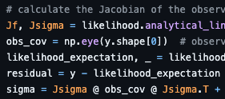
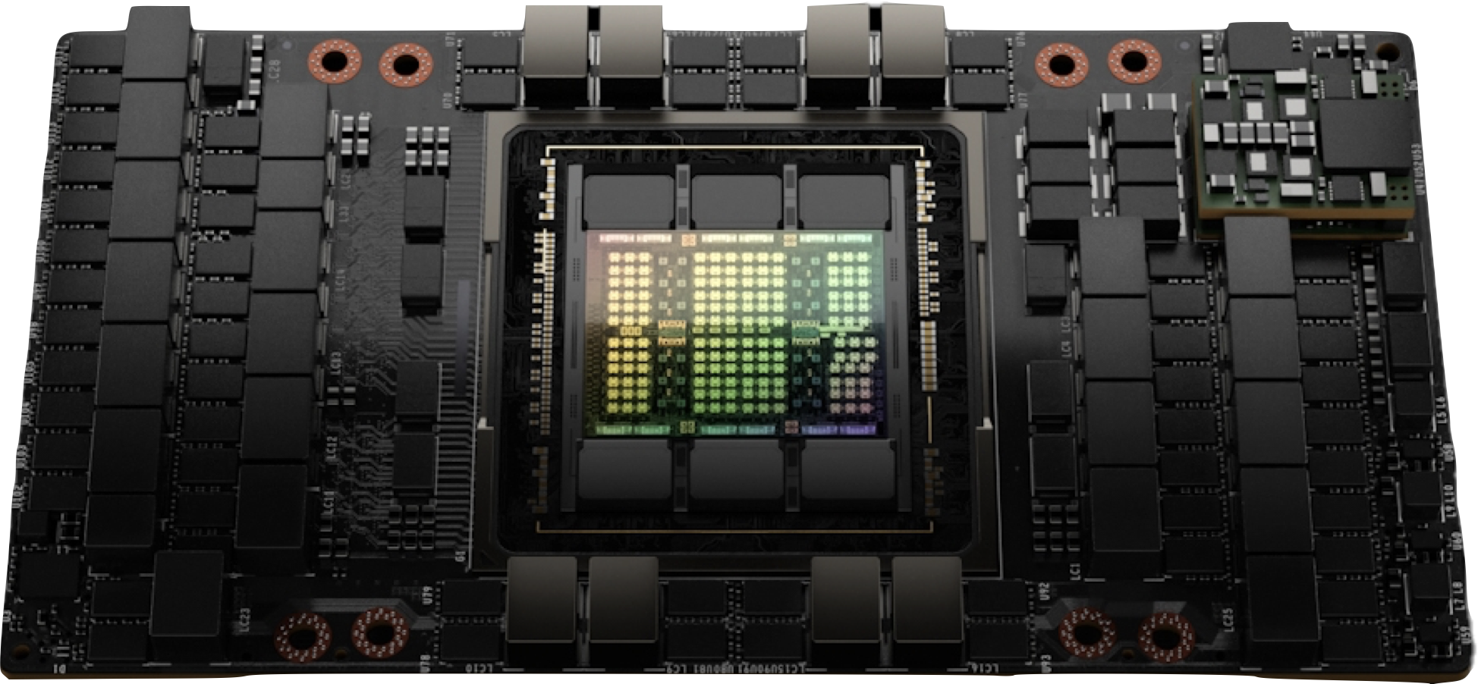
OpenXLA Compiler
TensorFlow
JAX
PyTorch
API: StableHLO + PjRt
OpenXLA
NVIDIA GPU
AMD GPU
x86 CPU
ARM CPU
Google TPU
Notes:
OpenXLA Compiler is a primariy ML-targeted compiler, which can compile models from the variety of frameworks, including TensorFlow, JAX and PyTorch.
It accepts StableHLO as an input, a computation graph with operations like matmuls, convolutions and multiplications expressed in a functional manner.
The graph is then optimized, and dispatched to a variety of backends, including GPUs, from NVIDIA and AMD, x86 or ARM CPU, or Google proprietary TPU hardware.

Slide 3


OpenXLA:GPU Architecture
StableHLO
HLO (w/ shardings)
Input
StableHLO computation graph
Optimizations Pipeline
…
Group HLOs into “Fusions”
Codegen each to CUDA kernel
…
Output
Serializable executable
Autotuning
OpenXLA:GPU
SPMD Partitioner
Cost Model
HLO (w/ collectives)
Algebraic Rewrites
Triton
TTIR
HLO (w/ above)
LLVM IR
Layout Assignment
HLO (w/ layouts & above)
LLVM
LLVM IR
Fusion
PTX
HLO (w/ fusions & above)
NVIDIA
Codegen
Scheduling
ptxas
Schedule
CUDA
binary
Bufferization
cuDNN, cuBLAS, NCCL, …
Buffer Assignment
JitRt
CUDA API
RuntimeIR / Object File
Runtime
Buffers
PjRt Executable
Notes:
Inside the OpenXLA:GPU compiler there is a number of optimization passes and a number of IRs, but the important bit for this talk is that at the compiler boundary we have StableHLO, which is an intermediate IR we convert computation graphs from various frameworks into, and inside the compiler we cluster those HLOs inside fusions, and then codegenerate them to PTX either directly or using TritonIR.

Slide 4

GPU Fusion
__global__ void Multiply(float a, float* x) {
int idx = threadIdx.x;
x[idx] = a * x[idx];
}
__global__ void Add(float* x, float* y) {
int idx = threadIdx.x;
x[idx] = x[idx] + y[idx];
}
__global__ void FusedMulAdd(float a,
float* x, float* y) {
int idx = threadIdx.x;
x[idx] = a * x[idx] + y[idx];
}
Fusion
Merging multiple instructions into a single kernel
Only fusion input/output is written to device memory
Intermediate values are passed inside registers/shared memory
Reduces memory bandwidth
Improves device occupancy
Notes:
Fusion is an optimization which merges multiple GPU kernels into one.
Consider an example on this slide, where we have two GPU kernels, one performing an elementwise multiplication by a constant, and another one performing addition of two arrays.
If our computation involves two such computations in a sequence, we can launch such two kernels to obtain the desired result. However, these kernels have almost no computations, and especially on modern GPUs which have humongous amount of compute available, the computation becomes throughput-bound.
And in this case we waste a lot of throughput: we have to read the entire input array from the device memory, then write it all out, then read it again, only to write it out later.
If we however *fuse* two kernels into one, as done on the right, we only have to read input and write output once, as intermediate values are passed in the registers (or in a programmable cache, as done in more complicated kernels). This way we save a large amount of throughput, and we can often also improve the device occupancy and save on the kernel launch overhead.

Slide 5
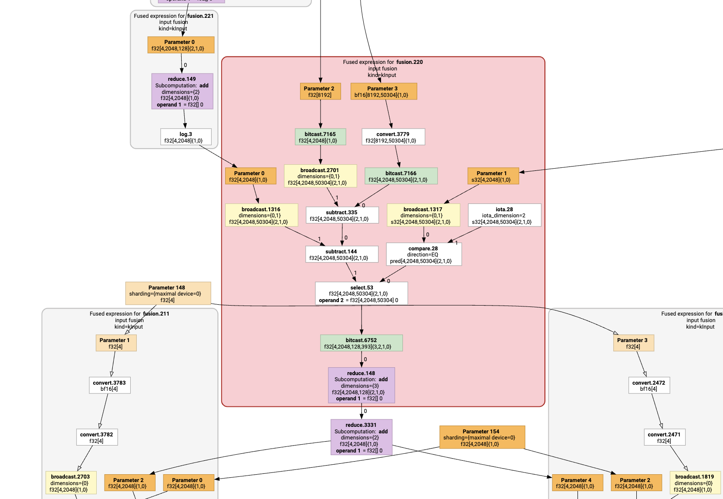
XLA Fusion
Clustering computation graph
Single fusion == single CUDA kernel
Intermediate instructions are not materialized
Passed in registers or __shared__
Saves bandwidth
Fusion limits
Compute limit
Shared memory limit
Register limit
…
Notes:
XLA:GPU performs fusions automatically on the input graph, grouping sets of HLO instructions into clusters. A single cluster forms a single CUDA kernel, with no intermediate instructions not on the fusion boundary materialized in the device memory.
We can’t grow such clusters limitlessly, as there are a number of budgets we have to be aware of. To start, GPUs only support a finite number of registers and shared memory, and going over the limit makes the fusion not worth it.
Furthermore, we’ve started with GPUs having a lot more compute than throughput, but as we fuse more and more instructions, especially if we start to duplicate them, the cost of the fusion could outweigh the benefit.

Slide 6
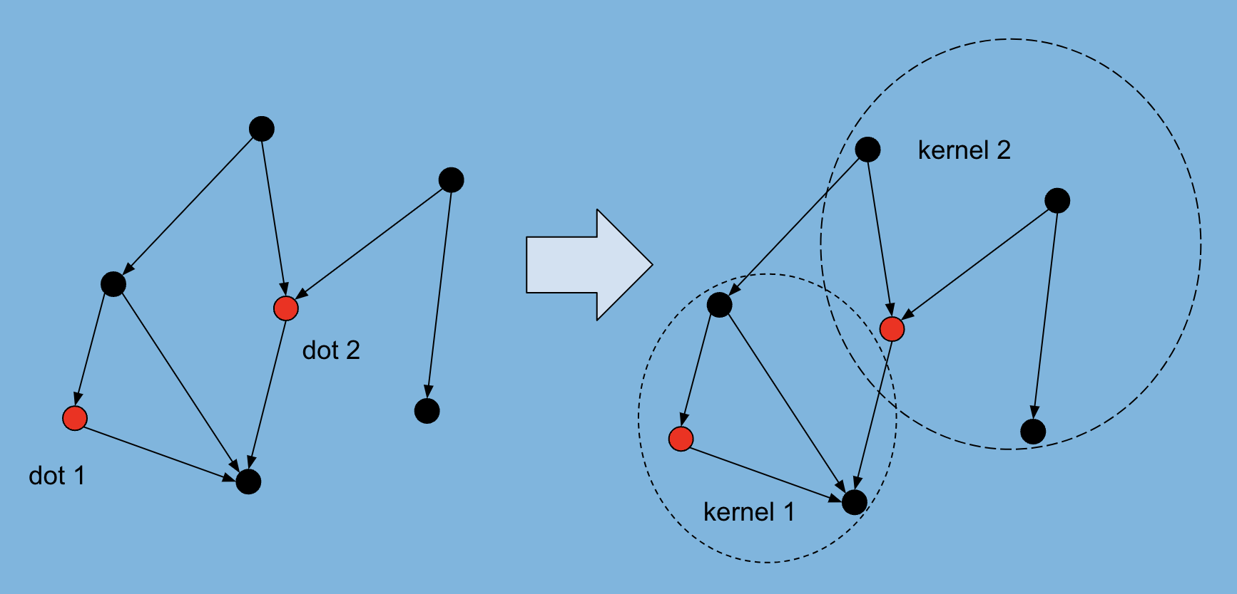
Clustering HLO graph into Fusions
Start fusions at complex (“root”) operations
E.g. matmuls
Fixed tiled codegen “recipe”
Grow fusions (add black dots) with tiling-compatible operations
Notes:
Let’s dive deeper into how such a clustering is chosen.
We start the clustering by “seeding” fusion roots at complex, usually compute-intesive operations, such as matmul or convolution, for which we know the codegeneration “recipe”. They are called fusion “roots” or “heros” and they determine the codegeneration strategy of the cluster.
Once such clusters are formed, we expand them, first “up” into producers, and then “down” into “consumers”, as long as the operations we merge into are tiling-compatible.

Slide 7
From HLO Fusion to TritonIR
“Hero” instruction determines tiling pattern
For each instruction in the fusion
Determine mapping from its dimensions onto “hero” instruction dimensions
Propagated by forwards/backwards projecting
Once mapping is calculated
Walk instructions in post order, run codegeneration
Notes:
Recall that the tiling of the fusion is determined by the root operation, and it’s dimensions. In order to generate TritonIR for each intermediate instruction, we need to know the mapping between the dimensions of an instructions, and tiled dimensions of the root operation. Thus we start the code generation by propagating such a mapping, first backwards into the prefix of the fusion, and then forwards, into an epilogue.
We describe such a mapping by storing a list of a pairs of integers per each instruction in a fusion. We call this list “DimensionOrder”.

Slide 8
Dimension Mapping from Tiled Instruction
Mapping determined by DimensionOrder
vector<{int tiled_dim, int count}>
tiled_dim: hero instruction dimension
Position in vector + count defines relation to the current instruction
Example:
Shape [38, 64], root instruction has 3 tiled dimensions (0, 1, 2)
Possible DimensionOrder: <(0, 19), (1, 2), (2, 64)>
Notes:
To get to TritonIR from HLO fusions, we start by backwards projecting a datastructure called DimensionOrder, which describes dimension mapping of each instruction in the fusion onto the dimensions of each tiled fusion root operation. Note that not all dimensions are tiled, for example, not the batch dimension of the matrix multiplication.
The datastructure is very simple, it’s a vector of pairs of integers, and we store one DimensionOrder per each instruction in a fusion.
A second integer is a dimension label, describing onto which dimension of the root instruction the current pair maps.
A position in this vector and a second integer in each pair identifies the dimension of the instruction this pair refers to. Note that just the position by itself is not enough (otherwise we could’ve just stored effectively a permutation over rank) as tiling can split or merge the dimensions.

Slide 9
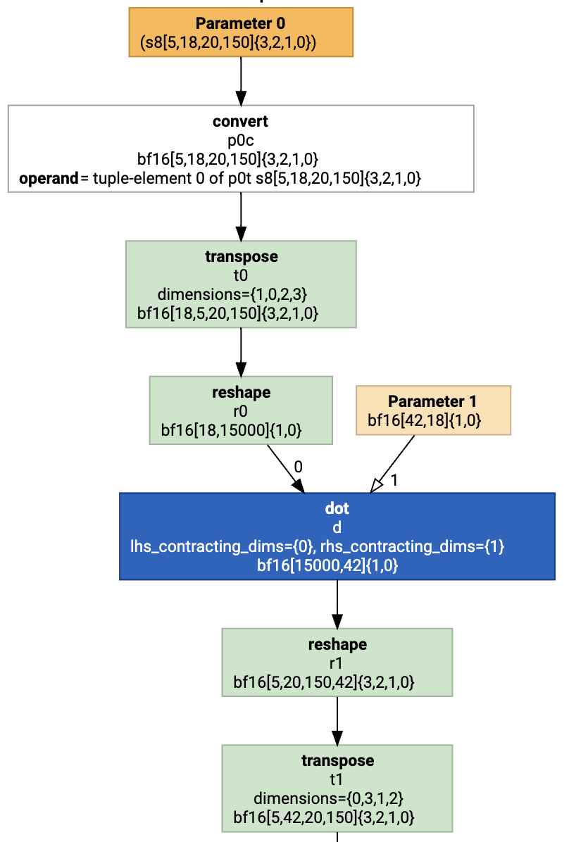
Prefix Dimension Mapping by Example
Label dimensions of input tensors of tiled operation
Matmul: non-batch dimensions are tiled
Propagate DimensionOrder (shown for LHS)
reshape
[(0, 18), (1, 15000)]
transpose:
[(0, 18), (1, 5), (1, 20), (1, 150)]
convert:
[(1, 5), (0, 18), (1, 20), (1, 150)]
parameter: (same as convert)
Notes:
Let’s walk this through with an example. We have a simple dot HLO, where the left hand side is a sequence of convert, transpose and reshape operations, and some further transformations are applied to the dot epilogue.
The “dot” operation has two tiled dimensions, dimension 0 of size 18, and dimension 1 of size 15’000, which simply turns into a corresponding vector. The reshape on the LHS breaks the dimension 1 into 3, so for the reshape “input” we store a vector of size 4, with the dimension 1 split into 5, 20 and 150 (note that on the diagram we show the shape for the HLO output, not input, but the DimensionOrder describes the dimension mapping for the instruction input).
Now transpose flips the positions of first and second element of the dimension mapping, while the convert leaves it unaffected.

Slide 10
Suffix Dimension Mapping by Example
Dimensions mapping: forward projection
dot
[(0, 15000), (1, 42)]
reshape:
[(0, 5), (0, 20), (0, 150), (1, 42)]
transpose:
[(0, 5), (1, 42), (0, 20), (0, 150)]
Notes:
The dot instruction has dimension order [(0, 15000), (1, 42)]. <- here differentiating between instruction input and output would start to become useful.
The reshape turns it into [(0, 5), (0, 20), (0, 150), (1, 42)], while the transpose makes the fast varying dimension second major instead, generating [(0, 5), (1, 42), (0, 20), (0, 150)].

Slide 11
Incompatible Tiling: Blocking Fusion
Consider
[3, 2] – reshape → [2, 3]
Dimensions have no common factors for tiling
=> Fusion is cut
If there is a common factor
Factorize dimension first, then treat like transpose

Slide 12
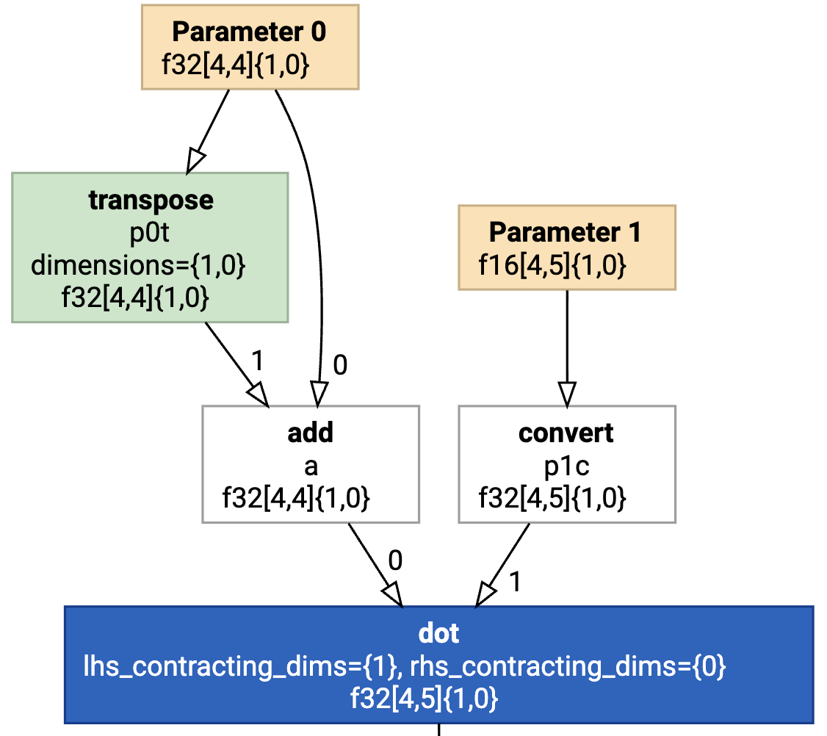
Merging Paths
Same tiling on LHS and RHS
=> merge
Different
=> potentially duplicate
Or stop fusion
Notes:
Let’s discuss some different situations which could occur while propagating the dimensions. Firstly, the computation graph is DAG and not a tree, and we can see the situations where the backwards path from the root merge in diamond fashion. In this case there are multiple options: if dimension mapping is the same for LHS and RHS we can merge the paths, but if it’s different,

Slide 13
Running Example: to TritonIR using Dimension Mapping
Parameter: becomes tl.load
5 becomes batch dimension (as major)
tl.TensorPtr([
(18, stride=3000),
(3000, stride=1)]
)
Convert: tl.convert
Transpose/reshape: accounted for in dimension transformation
Dot: kernel template, loop over contracting dimensions
Fusion Root: becomes tl.store
Notes:
Now that we know the dimension mapping, we could jump to codegeneration, which is performed in the postorder of the instructions. For the “parameter” operation we generate a single load. We know the dimension mapping at the root of the fusion, which is [(1, 5), (0, 18), (1, 20), (1, 150)]. For the load, 5, being major-most becomes a batch dimension, and the resulting TensorPtr we load consists of two dimensions: size 18 with stride 3000, and size 3000 with stride 1 (the product of split dimensions).
Going further down, convert is applied to the loaded tile, and transpose/reshape become no-ops, as they are already accounted for in the dimension mapping.

Slide 14
Choosing Tiling/Split-K with Autotuning
Choosing tiling for the resulting matmul/softmax/etc
Compile many, pick fastest
Use heuristics to cut the search space
SPLIT_K is also chosen by autotuning
Reductions executed as separate kernels
Potentially fused with other operations

Slide 15
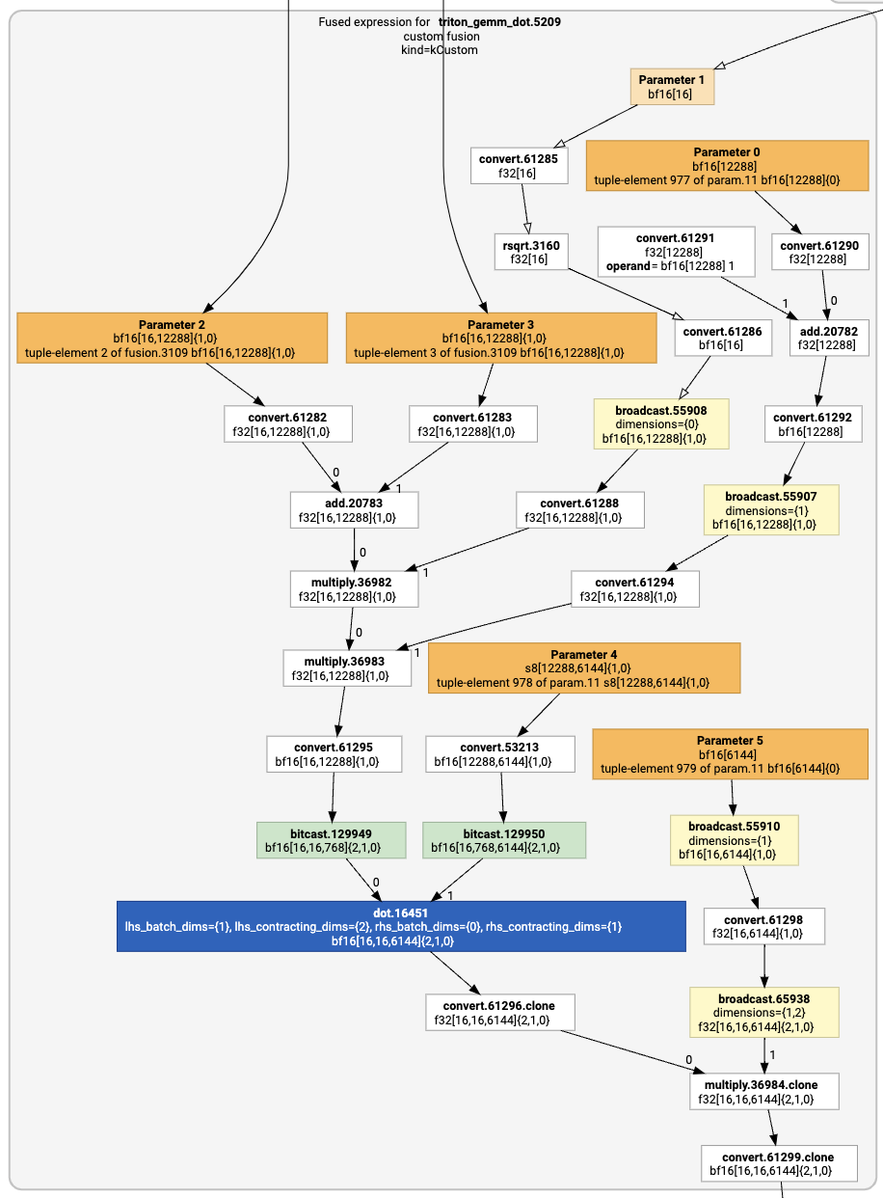

Slide 16
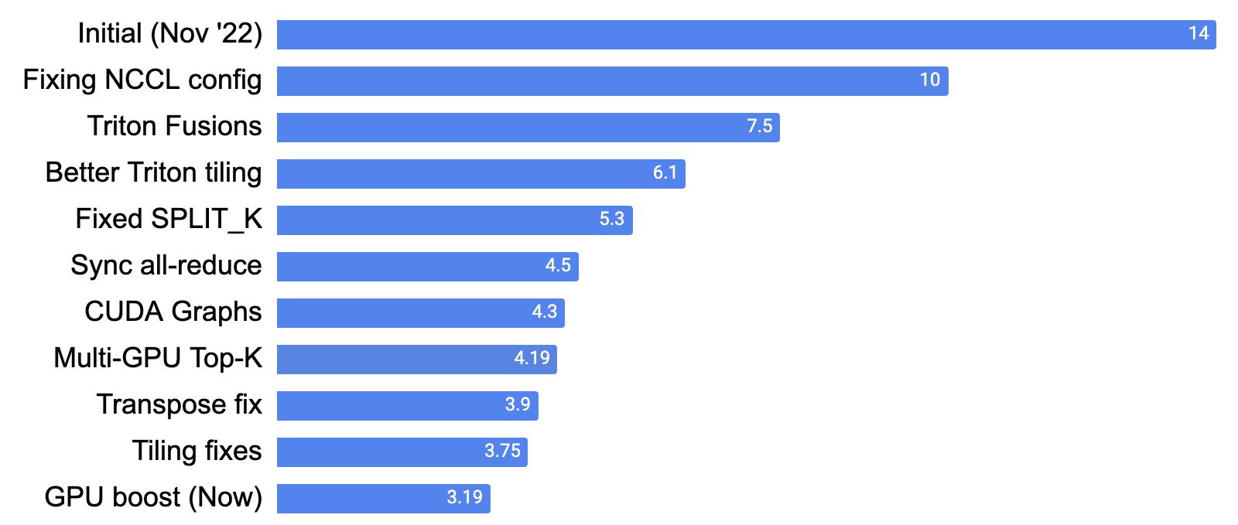
Performance
Triton Features
s
Notes:
TODO: Add more data

Slide 17
Future Work
Cost Model for Fusion
Intelligent choices when to cut fusions/when to duplicate
Cost Model for Tiling
Learned cost model to pick/cut the autotuning search space
State-of-the-art performance
Matmul pipelining not working in some cases
Cutlass able to achieve better performance on some fusions

Slide 18

Get started with OpenXLA today
github.com/openxla

